Slide 1
Groups

Slide 2
BUSINESS WEEK - PROGRAM
Today: Groups and start requirements (using UML)
Tuesday: Presentation of the examen-case by FOG A/S
Be avare that all classes meet in room 2.62 at 8.30!
After the presentation we continue with requirements (using UML)
Wednesday: we continue with requirements (using UML)
Thursday: working with requirements on the examen-case
Friday: individual SP-assignment

Slide 3
Today
Motivation/needs
Groups/teams
What to consider creating groups
Same academic level
Formal requirements
Groups of 4 students
GOAL OF THE DAY
All students are organized in groups at the end of the day.
The groups will work together all semester, and be responsible for handing in exam-project!

Slide 4
Maslow
Maslow's hierarchy of needs is a theory in psychology proposed by Abraham Maslow in his 1943 paper "A Theory of Human Motivation" in Psychological Review.
Maslow subsequently extended the idea to include his observations of humans' innate curiosity. His theories parallel many other theories of human developmental psychology, some of which focus on describing the stages of growth in humans.
Maslow used the terms "physiological", "safety", "belongingness" and "love", "esteem", "self-actualization", and "self-transcendence" to describe the pattern that human motivations generally move through.

Slide 5
Maslow’s Hierarchy of Needs
Self-Actualization
Esteem
Love
Safety
Physiological
What motivates us to do what we do, eg . study, work , play soccer , go to a bar?
Important knowledge when planning work, especially work in teams!

Slide 6
Maslow’s Hierarchy of Needs
Self- actualization
Esteem needs
Love, Affection and belongings needs
Safety needs
Physiological or survival needs
Self-actualization means actualizing one’s potential becoming all one is capable of becoming
Achievement, mastery, independence, status, dominance, prestige, self-respect, respect from others.
Friendship, intimacy, affection and love, - from work group, family, friends, romantic relationships.
On the whole an individual cannot satisfy any level unless needs below are satisfied
Most needs have to do with survival physically and psychologically

Slide 7
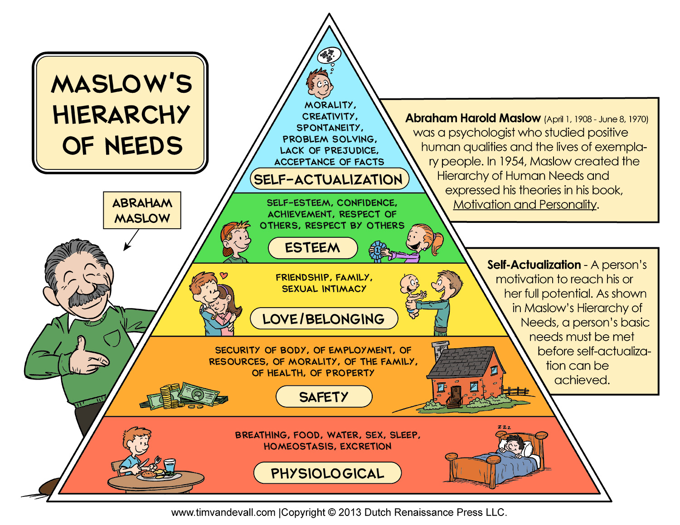

Slide 8
Groups

Slide 9
Nobody can do everything,
But we can nearly all do more than we think we can
Remember this for the next couple of months ☺

Slide 10
Groups/Teams
What to consider creating groups
Same academic level
GREEN, YELLOW, RED – ring a bell?
Skills
Analysing
UML
Programming
DB
Cooperation/group-skills
Writing report
Presentation

Slide 11
Groups/Teams
Complementary Skills
“Getting along" is not the most important feature of a team.
While it's true that team members must work together, being friends is not the key issue.
In contrast, great teams accomplish their work largely because the teams bring together the right mix of different skills and understandings

Slide 12
Development of a group
Forming
Forming is the stage when the group first comes together. Everybody is very polite and very dull. Conflict is seldom voiced directly, mainly personal and definitely destructive. Since the grouping is new, the individuals will be guarded in their own opinions and generally reserved. This is particularly so in terms of the more nervous and/or subordinate members who may never recover. The group tends to defer to a large extent to those who emerge as leaders (poor fools!).
Storming
Storming is the next stage, when all Hell breaks loose and the leaders are lynched. Factions form, personalities clash, no-one concedes a single point without first fighting tooth and nail. Most importantly, very little communication occurs since no one is listening and some are still unwilling to talk openly. True, this battle ground may seem a little extreme for the groups to which you belong - but if you look beneath the veil of civility at the seething sarcasm, invective and innuendo, perhaps the picture come more into focus.
Norming
Then comes the Norming. At this stage the sub-groups begin to recognize the merits of working together and the in-fighting subsides. Since a new spirit of co-operation is evident, every member begins to feel secure in expressing their own view points and these are discussed openly with the whole group. The most significant improvement is that people start to listen to each other. Work methods become established and recognized by the group as a whole.
Performing
And finally: Performing. This is the culmination, when the group has settled on a system which allows free and frank exchange of views and a high degree of support by the group for each other and its own decisions. In terms of performance, the group starts at a level slightly below the sum of the individuals' levels and then drops abruptly to its nadir until it climbs during Norming to a new level of Performing which is (hopefully) well above the start. It is this elevated level of performance which is the main justification for using the group process rather than a simple group of staff.

Slide 13
High Performance Teams Have
Commitment and desire to achieve results
Well-developed identity as a team, with shared vision and goals
Competence as individuals
Complementary skills
Mutual trust and interdependence. Trust is based on honesty, openness, consistency, and respect.
Effective Communication
Small size, 4-7 members (consider number of communication links)
High level of enjoyment
Remember that the most important goal for a group in this project is learning

Slide 14
Conflicts in teams
Conflict needs to be addressed
Careful not to smooth over
Could conflict be both positive and negative?
Personal conflict versus team objectives
Consensus versus “disagree and commit”
Agreement on norms crucial before teams can perform
Consider above mentioned potential conflicts and ”high performance teams” and make:
GROUP-CONTRACT!

Slide 15
Belbin Test
The Belbin Team Inventory is a behavioral test

Slide 16

Belbin Test
The Belbin Team Inventory is a behavioral test, also called the Belbin Self-Perception Inventory, Belbin Team Role Inventory, SPI or BTRSPI.
It was devised by Meredith Belbin to measure preference for nine Team Roles; he had identified eight of those whilst studying numerous teams at Henley Management College.

Slide 17
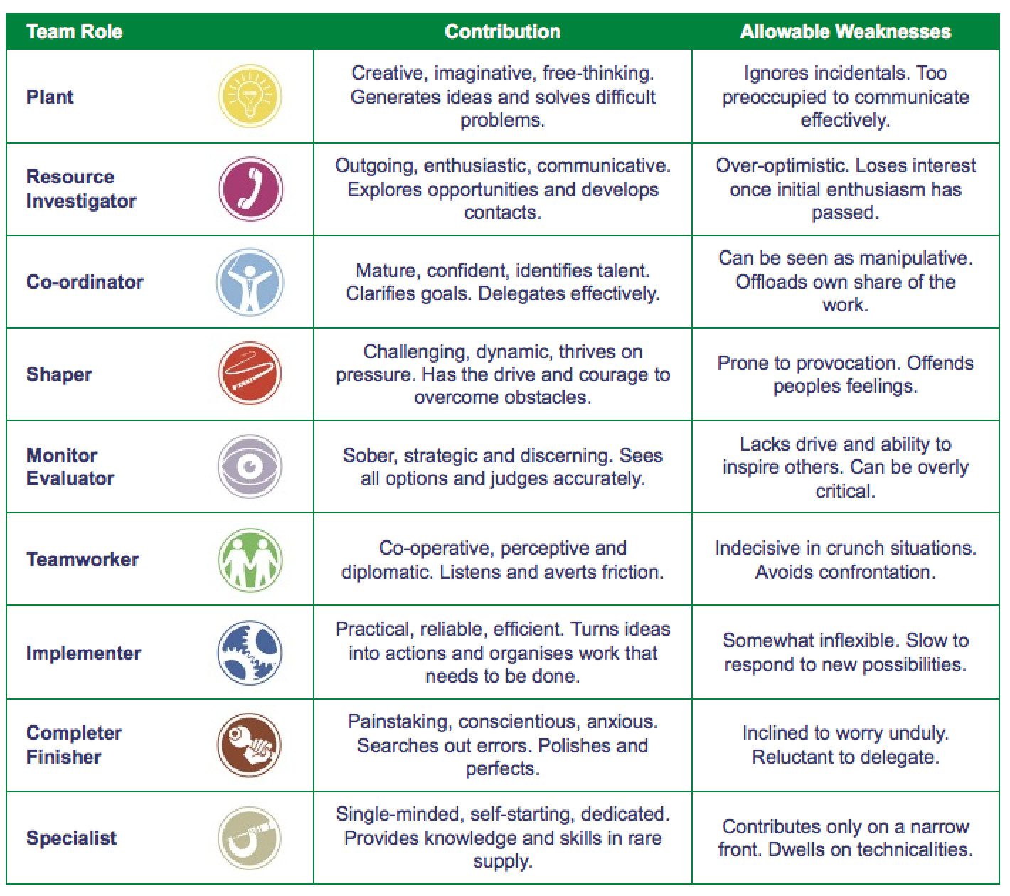

Slide 18
Action-oriented roles -
SHAPER, IMPLEMENTER & COMPLETER FINISHER
People-oriented roles -
CO-ORDINATOR, TEAMWORKER & RESOURCE INVESTIGATOR
Cerebral roles -
PLANT, MONITOR EVALUATOR & SPECIALIST
TEAM ROLE OPPOSITES
MONITOR EVALUATOR -
judges impartially
PLANT -
theorises
CO-ORDINATOR -
generalises
COMPLETER FINISHER -
perfects established
systems
SHAPER -
drives
RESOURCE
INVESTIGATOR -
recognises opportunities
TEAMWORKER -
supports
SPECIALIST - specifies
IMPLEMENTER - applies
Notes:
18

Slide 19
Exercise
Consider the different Belbin-roles regarding yourself
What is my primary role and what is my secondary role?
Talk with one or more fellow students and get their opinion on
What is your primary role and what is your secondary role?
Do the test: Belbin-test (on fronter) - Excel
Consider the results – match or not?

Slide 20
Before you leave today
Put in the names of the group
member in this Google Doc
B
https://docs.google.com/document/d/1VJ-EQv6A_jcGqxpJgjryiBGFWzcdaR3g6W0qbONv9vw/edit?usp=sharing
Cos
https://docs.google.com/document/d/1KSLjowYPLTm5Ct1ZjDGO6DTqRJNNijMUStLfUSCzOa8/edit?usp=sharing
If you are not in a group, contact me!

